Slide 1
CMMI Overview
Dr. Korson
Software Engineering

Slide 2
Maturity vs. Immaturity
Immature organizations can be successful on occasion, but ultimately run into difficulties because
Success depends on “heroics” which cannot be guaranteed to be repeated
Success depends on having the same people on the team, whereas the industry employee turnaround is high

Slide 3
Characteristics of Immaturity
Immature organizations
Processes are improvised
Reactive, not proactive
Cost overruns and delays are frequent
Quality is unreliable

Slide 4
Maturity
Processes are managed throughout the organization
Quality is assessed quantifiably
Schedules and budgets are based on historic performance

Slide 5
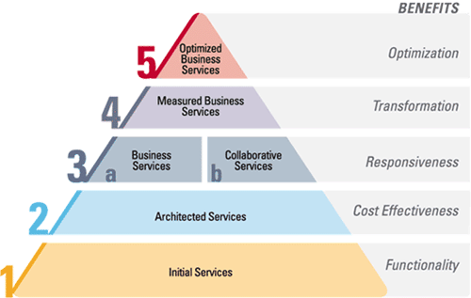
CMMI
CMMI focuses on the maturity of your processes

Slide 6
Quality Leverage Points
Everyone realizes the importance of having a motivated, quality work force but...
PEOPLE
...even our finest people can’t perform at their best when the process is not understood or operating “at its best.”
TECHNOLOGY
PROCESS
Major determinants of product cost, schedule, and quality
Notes:
See notes on slide 5

Slide 7
Underlying Premise of Process Improvement
“The quality of a product is largely determined by the quality of the process that is used to develop and maintain it.”

Slide 8
Categories of Process Improvement Benefits
Process improvement benefits fall into eight general categories:
improved schedule and budget predictability
improved cycle time
increased productivity
improved quality (as measured by defects)
increased customer satisfaction
improved employee morale
increased return on investment
decreased cost of quality
Notes:
See notes on page 11

Slide 9
The Maturity Levels
Optimizing
Optimizing
5
Focus on continuous process improvement
Quantitatively
Managed
4
Process measured and controlled
Defined
Defined
3
Process characterized for the organization and is proactive
Managed
2
Process characterized for projects and is often reactive
Initial
1
Process unpredictable, poorly controlled, and
reactive

Slide 10
Maturity Levels Cannot Be Skipped It Is Organizationally Impossible
Each maturity level provides a necessary foundation for effective implementation of processes at the next level.
Higher level processes have less chance of success without the discipline provided by lower levels.
The effect of innovation can be obscured in a noisy process.
Higher maturity level processes may be performed by organizations at lower maturity levels, with the risk of not being consistently applied in a crisis.

Slide 11
Capability Levels
A capability level is a well-defined evolutionary plateau describing the organization’s capability relative to a process area.
There are six capability levels.
For capability levels 1-5, there is an associated generic goal.
Each level is a layer in the foundation for continuous process improvement.
Thus, capability levels are cumulative, i.e., a higher capability level includes the attributes of the lower levels.

Slide 12
CMMI in a Nutshell
A CMMI model provides a structured view of process improvement across an organization
CMMI can help
set process improvement goals and priorities
provide guidance for quality processes
provide a yardstick for appraising current practices

Slide 13
Benefits of Continuing Process Improvement
SEI Software CMM Level 5: For the Right Reasons*
Defects are now nearly all found and fixed before testing begins.
Defects escaping into the field have been reduced from 11% to practically 0%.
Programs consistently reach customer satisfaction and performance targets.
Peer reviews increase total project costs by 4%, but reduced rework during testing by 31%. R.O.I. is 7.75:1.

Slide 14
CMM“I” – Integration
Provides expanded model scope for integration
Integrated Product Management
Integrated Supplier Management
Decision Analysis and Resolution
“Relevant Stakeholder” planning and execution
Inclusion of the Integrated Product and Process Development body of knowledge

Slide 15
Each Process Area
Process Areas (PA)
Specific Goals (SG) Required
Specific Practices (SP) Expected
Typical Work Products Informative
Sub-practices Informative
Notes Informative
Discipline Amplifications Informative
References Informative
Generic Goals (GG) Required
Generic Practices (GP) Expected
Generic Practice Elaborations Informative

Slide 16
Specific Practices
Example Requirements Mgmt.
SG 1 Manage Requirements
SP 1.1 Obtain an Understanding of Requirements
SP 1.2 Obtain Commitment to Requirements
SP 1.3 Manage Requirements Changes
SP 1.4 Maintain Bidirectional Traceability of Requirements
SP 1.5 Identify Inconsistencies between Project Work and Requirements

Slide 17
Process Areas by Maturity Level
Level
Focus
Process Areas
Continuous
Organizational Innovation and Deployment
Causal Analysis and Resolution
5 Optimizing
process
improvement
4 Quantitatively
Managed
Quantitative
management
Organizational Process Performance
Quantitative Project Management
Requirements Development
Technical Solution
Product Integration
Verification
Validation
Organizational Process Focus
Organizational Process Definition
Organizational Training Integrated Project Management
Integrated Supplier Management
Risk Management
Decision Analysis and Resolution
Organizational Environment for Integration
Integrated Teaming
3 Defined
Process
standardization
(SS)
(IPPD)
(IPPD)
Basic
project
management
Requirements Management
Project Planning
Project Monitoring and Control
Supplier Agreement Management
Measurement and Analysis
Process and Product Quality Assurance
Configuration Management
2 Managed
1 Initial

Slide 18
Project Management Process Areas
There are eight Project Management Process Areas.
Project Planning
Project Monitoring and Control
Integrated Project Management (IPPD)
Risk Management
Supplier Agreement Management
Quantitative Project Management
Integrated Supplier Management (SS)
Integrated Teaming (IPPD)

Slide 19
Project Planning - Capability Level 1
Project Planning
Specific Practices (CL1 - “Base Practices”)
SP1.1-1: Estimate the Scope of the Project
SP1.2-1: Establish Estimates of Work Product and Task Attributes
SP1.3-1: Define Project Life Cycle
SP1.4-1: Determine Estimates of Effort and Cost
SP2.1-1: Establish Budget and Schedule
SP2.2-1: Identify Project Risks
SP2.3-1: Plan for Data Management
SP2.4-1: Plan for Project Resources
SP2.5-1: Plan for Needed Knowledge and Skills
SP2.6-1: Plan Stakeholder Involvement
SP2.7-1: Establish the Project Plan
SP3.1-1: Review Plans that Affect the Project
SP3.2-1: Reconcile Work and Resource Levels
SP3.3-1: Obtain Plan Commitment
If all of the base practices are performed,
Then, the associated Specific Goals and Generic Goal 1 are satisfied,
So, the Process Area is rated at Capability Level 1 (CL1) - Performed.

Slide 20
Building Process Capability
Level 5
Generic
Practices
Optimizing
Process
Capability
Level 4
Generic
Practices
Quantitatively
Managed
Process
Level 3
Generic
Practices
Defined
Process
Level 2
Generic
Practices
Managed
Process
Performed
Process

Slide 21
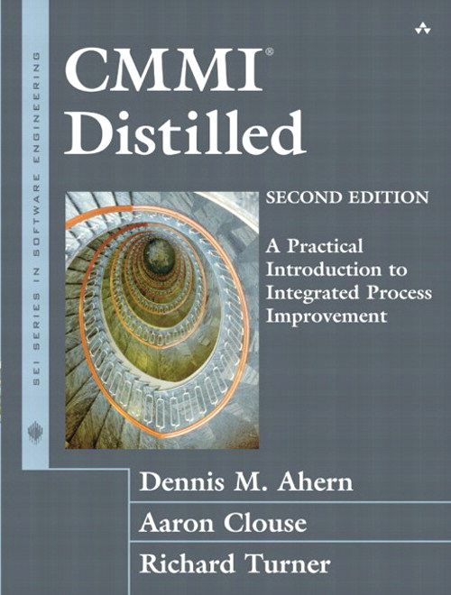
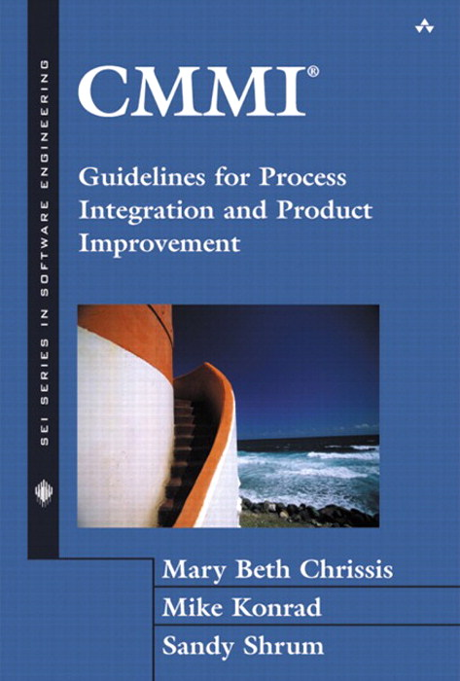
Further Reading

