Slide 1
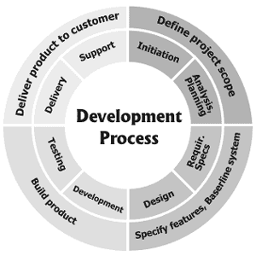
CPTE 209 Software Engineering
Summary and Review

Slide 2
Course Objectives Students will be able to:
Identify the appropriate process model for a software project based on an analysis of the nature of the application and project circumstances
Synthesize elements from the various process models to create a custom process model tailored to the situation at hand.

Slide 3
Quasi Agile Principles
Whenever there is a problem have a conversation
Always use the lightest weight possible mechanism to solve the problem
Face to face communication is faster, cheaper, higher bandwidth, and less ambiguous than written documentation.
Low tech solutions are faster, cheaper, and more likely to be used that complicated hi-tech solutions.
The cost of a process step must always be weighed against the cost of the implementation and the risk it mitigates
Always give simple, low tech solutions a chance, but use a more complex solution if needed.

Slide 4
Balancing Agility and Discipline
Plan Driven Agile
Personnel
Less skilled – Highly Skilled
Criticality
Many lives, Single life, Essential Funds, Discretionary funds, Comfort
Project Size
300, 100, 30, 10, 3
Culture
Requires Order, Thrives on Chaos
Dynamism
Very stable requirements, Highly volatile requirements

Slide 5
Balancing Agility and Discipline
Plan Driven Agile
Industry oversight
Heavily regulated, somewhat regulated, unregulated
Hardware dependencies
Embedded, custom attached devices, desktop application
Organizational culture
Suit and tie, business casual, jeans
Industry type
Commercial businesses; Hi tech: compilers, OS
Funding capability
Deep pockets, standard funding, shoestring budget
Organization size
Huge: government; Small: start up
Client Interaction
Formal – document based; Close – interpersonal
Risk
Architecture, Technology; Requirements, Business Value

Slide 6
Course Objectives Students will be able to:
Identify and explain the sources of complexity in software systems and projects

Slide 7
Course Objectives Students will be able to:
List and explain the fundamental principles of good software engineering
Domain Analysis Based
Architecture-Centric
Use-Case Configured
Component Biased
Quality Engineered

Slide 8
Use-Case Configured
Business Goals & Technical System
Requirements
Domain
Relationships
Commercial Standards &
Frameworks
Architecture
Use Cases
Application

Slide 9
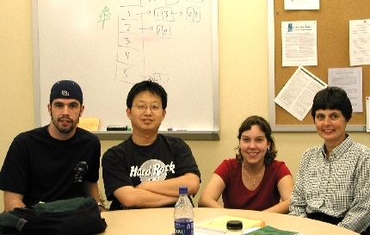
Course Objectives Students will be able to:
Analyze the impact of continuous integration, incremental development, and early and frequent releases on the development team and stakeholders.

Slide 10
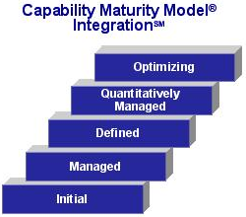
Course Objectives Students will be able to:
Analyze the appropriateness of various process improvement models to a given corporate situation.
CMMI
ISO 900X

Slide 11
Course Objectives Students will be able to:
Acquire and document customer requirements for a software application
Discuss the problems inherent in requirements definition and describe how to help compensate for these difficulties.
Client knowing what they want
Client knowing the cost
Client knowing what technology can do
Client being able to articulate what they want
Developers understanding the requirements
Lack of domain knowledge
Ambiguous requirements
Missing requirements
Assumed requirements
Project

Slide 12
Course Objectives Students will be able to:
Discuss the difference between software development as a process of transforming a fixed set of requirements into software and software development as a means of delivering value to a set of stakeholders.
??????????
Software Development Process
input
output
Software System

Slide 13
Course Objectives Students will be able to:
Describe the differences between architectural design and detail design.
Components (subsystems, etc.)
Interfaces to each component
Relationships between components
Patterns of interactions
Constraints
Create an appropriate object-oriented design by applying OO design patterns and principles to a given set of requirements
An architecture for a system is the pattern of connections among the basic components of the system; the pattern embodies the relations and constraints among the constituent pieces of the system.

Slide 14
Course Objectives Students will be able to:
Explain the various types of testing and review procedures and their applicability and limitations
Unit testing
Integration testing
System testing
Functional requirements
Quality requirements
Contribute to the formation of a work breakdown structure for a project
What tasks are necessary to the creation of a simple website for a small business
Black Box
White Box
www.mywebsite.com

Slide 15
Course Objectives Students will be able to:
Discuss the use of product metrics to access the quality of software
Time and effort to change software over time
Complexity
Number of entries in the issue tracking database
Discuss the use of process metrics to access the progress of software development
% stories running and tested
Lines of code or function points completed
Discuss the use of risk analysis to guide project decisions and communicate levels of uncertainty to stakeholders
Frequency, criticality, complexity -> Risk
Acceptance, mitigation, prevention
Best case, expected case, worse case and WHY

Slide 16
Course Objectives Students will be able to:
Discuss the interlocking activities, phases, roles, processes, and procedures of the software engineering process
Domain analysis, Application analysis, Architecture, Detail Design, Implementation, Integrate and test
Describe the primary reasons for project failure and discuss preventative measures for each
We fail to properly manage risks
We don’t build the right thing
We are blindsided by technology

Slide 17
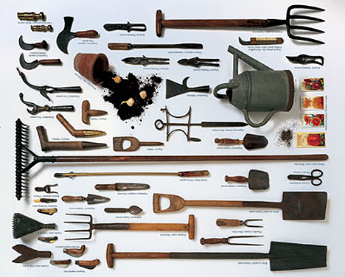
Course Objectives Students will be able to:
Discuss the categories of tools that support the software engineering process and evaluate the importance of each category for a given project
Use an appropriate modern software engineering toolset for a given software project

Slide 18
Automated Tools
Developer
CASE
Compiler
Debugger
Class browsers
GUI and DB
builder
Configuration
management
Web development tools
Testing
Installshield
DBMS, Middleware
Report Writer
Build tools

Slide 19
Automated Tools
Project Management
Project planning and tracking
Estimating
Scheduling
Both
Word processor
text editor
Spreadsheet
Group
communications
Defect tracking
Web Browser

